Slide 1


UB Talker
Student Researchers: Dominique Hickson¹, Jennifer Barker³, Olivia Spellicy² ,Jeremy Pettroto¹, Megan Yoerg³, MacKenzie Bardsley³, Zachary Salim¹, Ian Kaminer¹, Michael Mincone¹, Arnav Matta⁵, Corey Ropell¹, Devon Rennoldson⁴, Sriram Subramanian¹ Faculty Mentor: Dr. Kris Schindler¹
Departments: ¹Computer Science and Engineering, ²Communicative Disorders and Sciences , ³Nursing, ⁴Cognitive Science, ⁵Mechanical Engineering

Slide 2
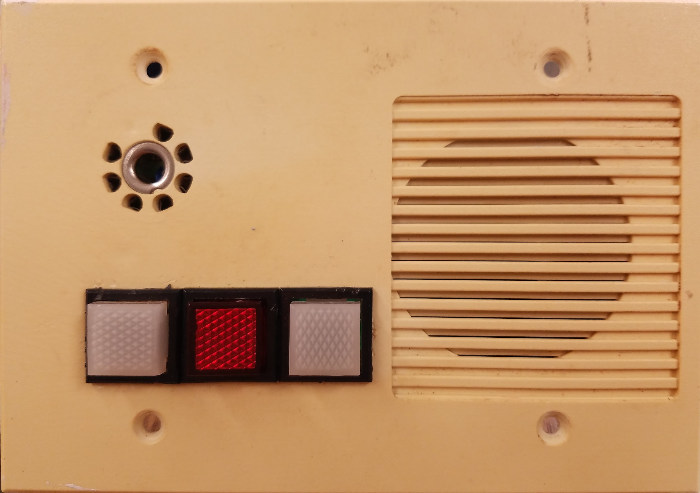
What is UB Talker?
An Augmentative and Alternative Communication (AAC) device requiring little to no physical ability aiding patients with complex communication needs.
Provides a way for patients to construct words and sentences without using their voice.
Speech generating device: Provides Text-to-Speech to verbally hold a conversation
Control various devices (TV, lamp, Call Light, etc.)

Slide 3
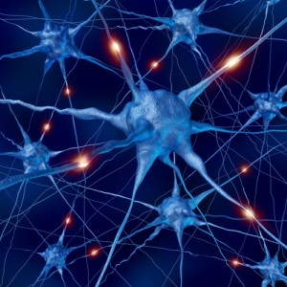
Our former client, Tim
Advanced case of ALS
Complete loss of motor function
Can’t speak or move
Still strong mentally
Tim passed in August 2017

Slide 4
What is ALS?
Amyotrophic Lateral Sclerosis
Progressive disease that affects all voluntary muscles
Eventually disables the patient’s ability to: move, speak or otherwise communicate, and breathe on their own
Positive: patients will NOT lose control over eye movement
Eye Tracking technology
ALS has a relatively predictable progression, so communication devices can follow a common trend and be tailored to each individual

Slide 5
What is a stroke?
When a stroke occurs, blood supply to the brain becomes blocked, killing brain cells.
In some patients this will cause speech and language problems.
Potentially causing one or both types of Aphasia:
Wernicke’s (unable to understand speech) & Broca’s (Unable to produce speech)

Slide 6
Important:
No two patients are the same:
With each patient we get to know their personal needs and wants to create the best form of communication for them.

Slide 7
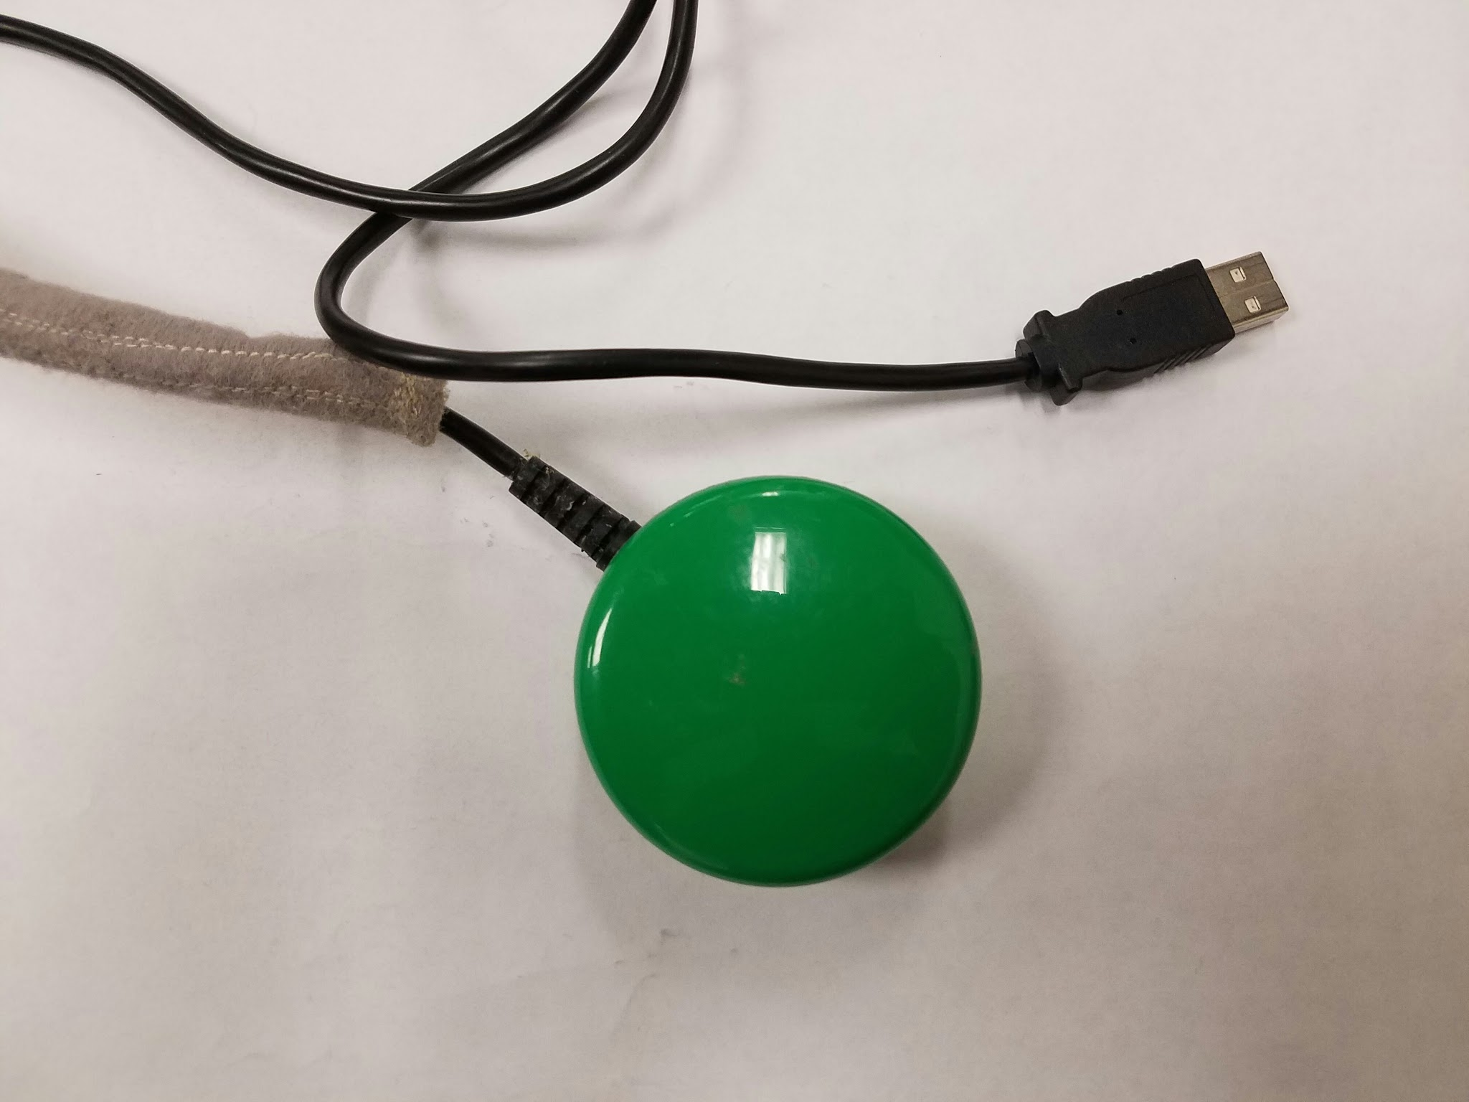
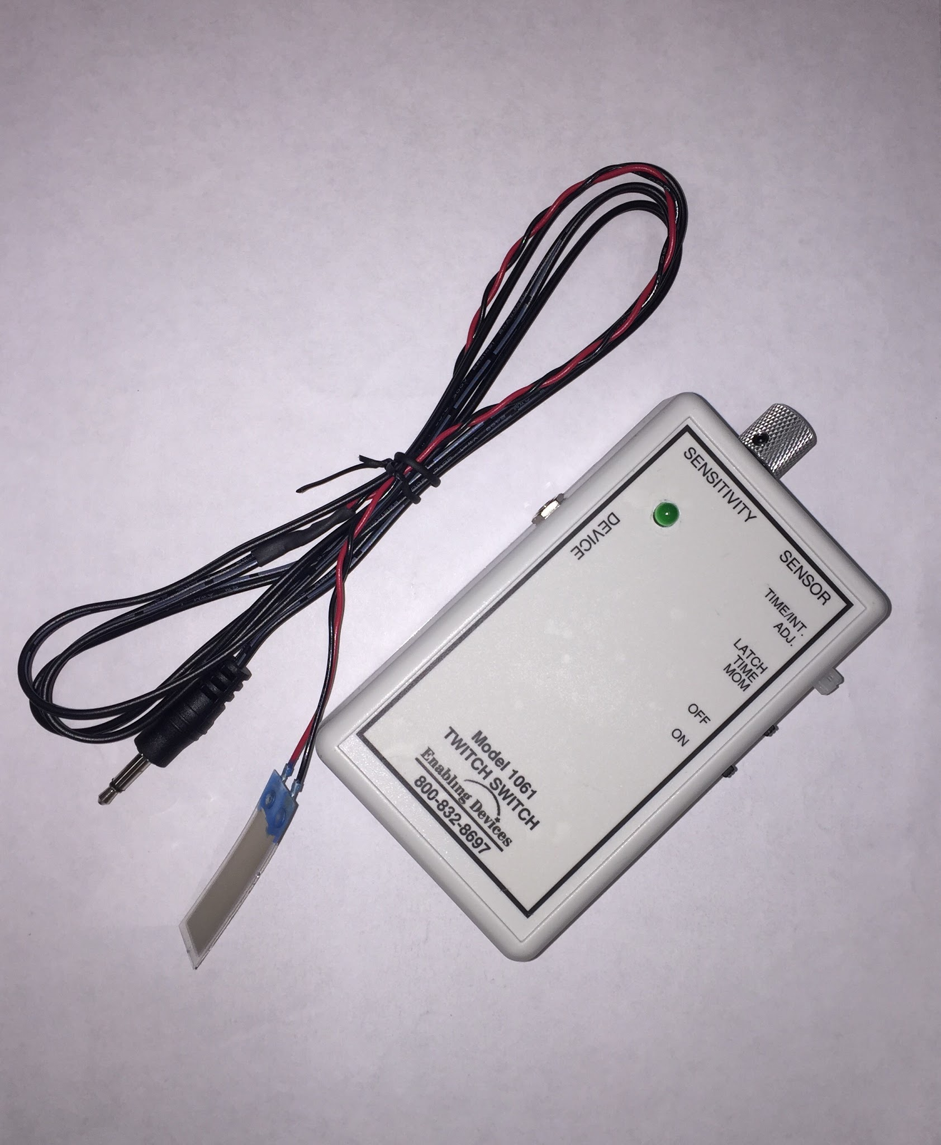
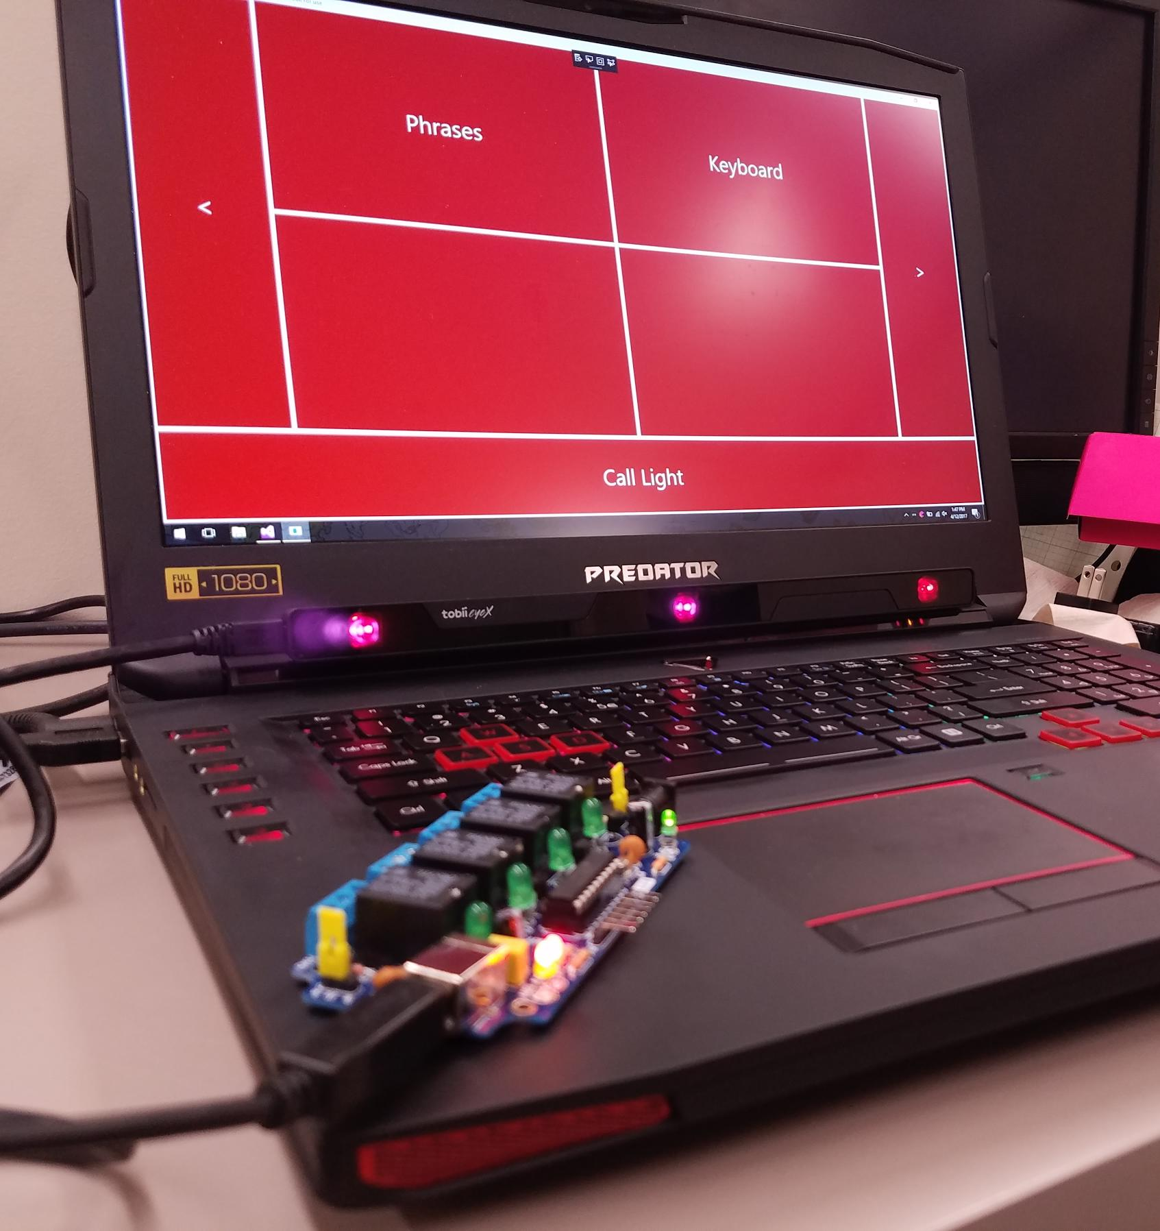
Generations of Devices
Push Button
Can be used with any body part
Need sufficient pressure to press
Twitch Switch
Variable Sensitivity- bend strip
Limited locations on the body
Eye-Tracking Communication Device (ETCD)
Detects users pupils, only requires eye movement

Slide 8
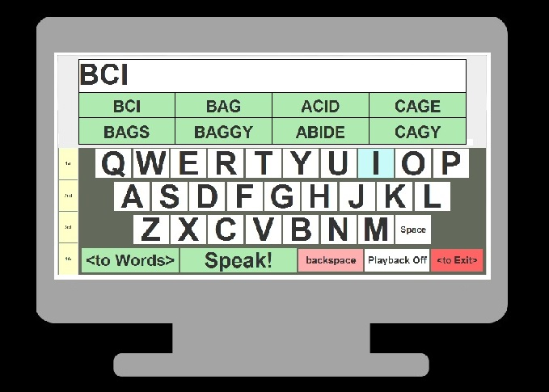
Java Application
Application cycles through options
Peripheral device used to select options
Cycles through rows
Cycles through columns
Selection by mouse click
Advantage: Accurate
Disadvantage: Slow

Slide 9
Tobii EyeX: How does it work?
PCCR- pupil centre corneal reflection
Near-infrared light is used to illuminate the eyes, and a camera is used to capture images of the reflections
Advanced image processing algorithms are used to calculate and determine the position of the eye and the gaze direction

Slide 10
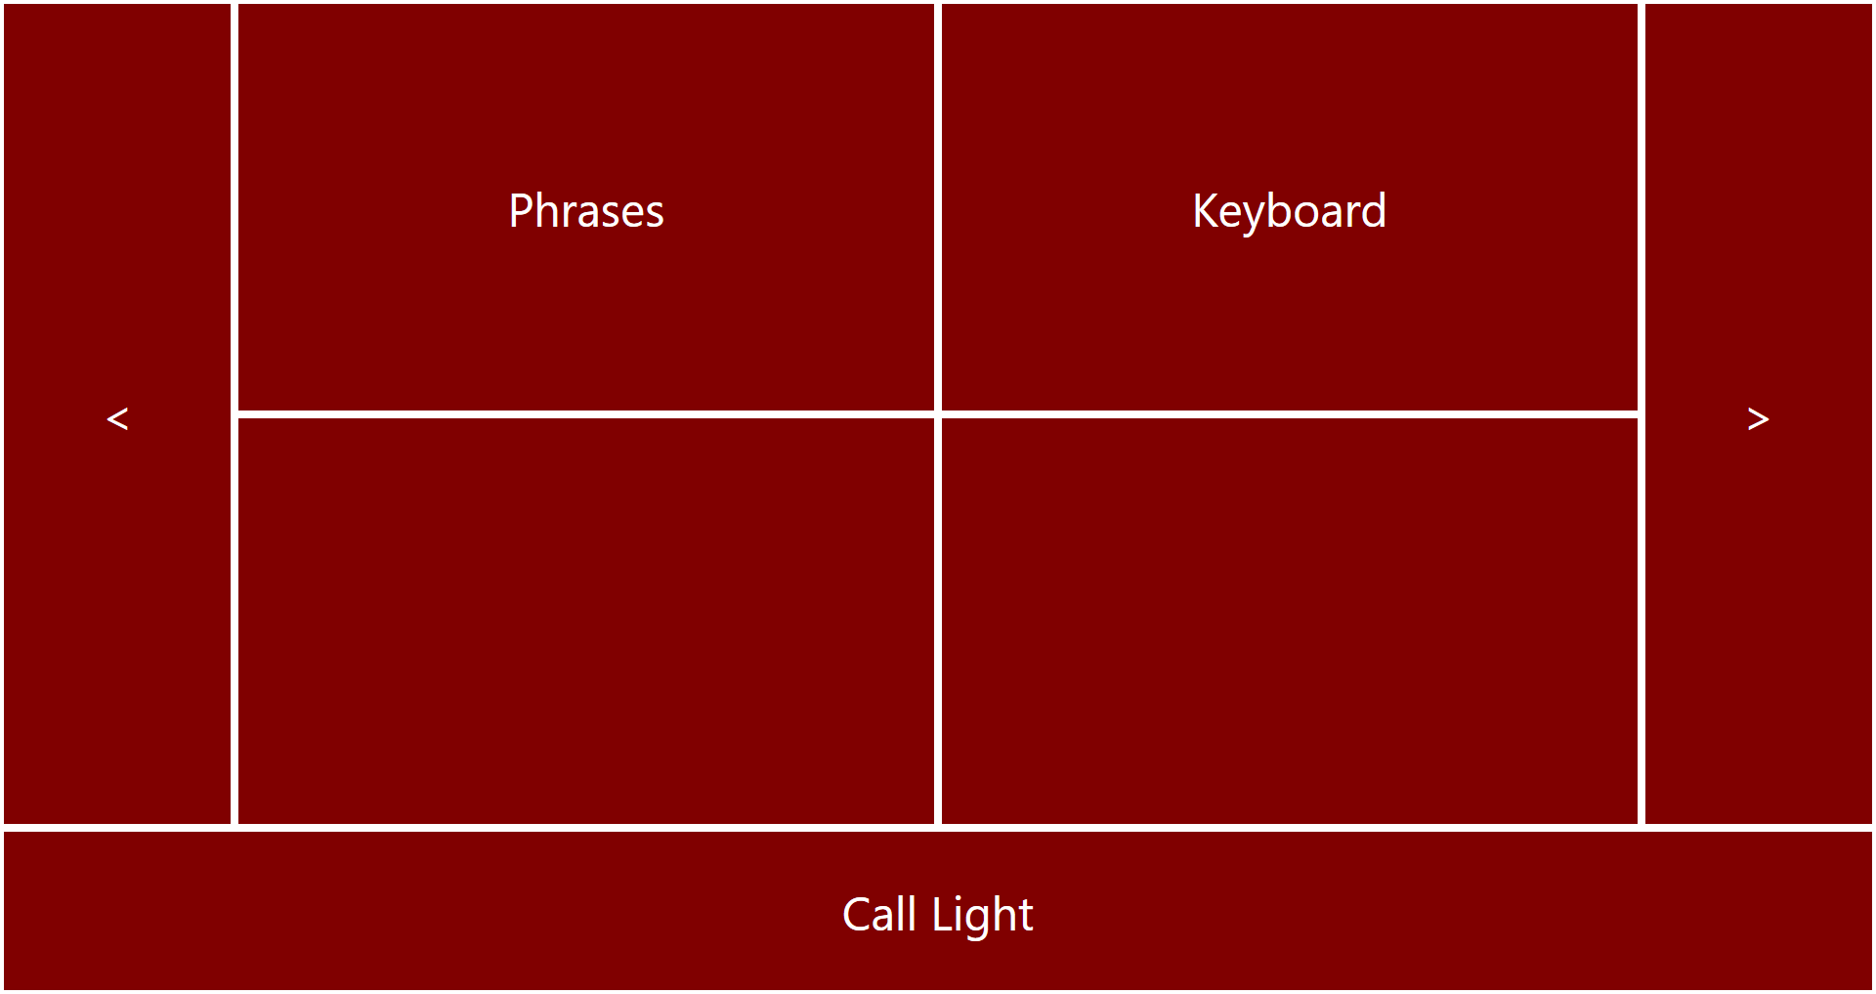
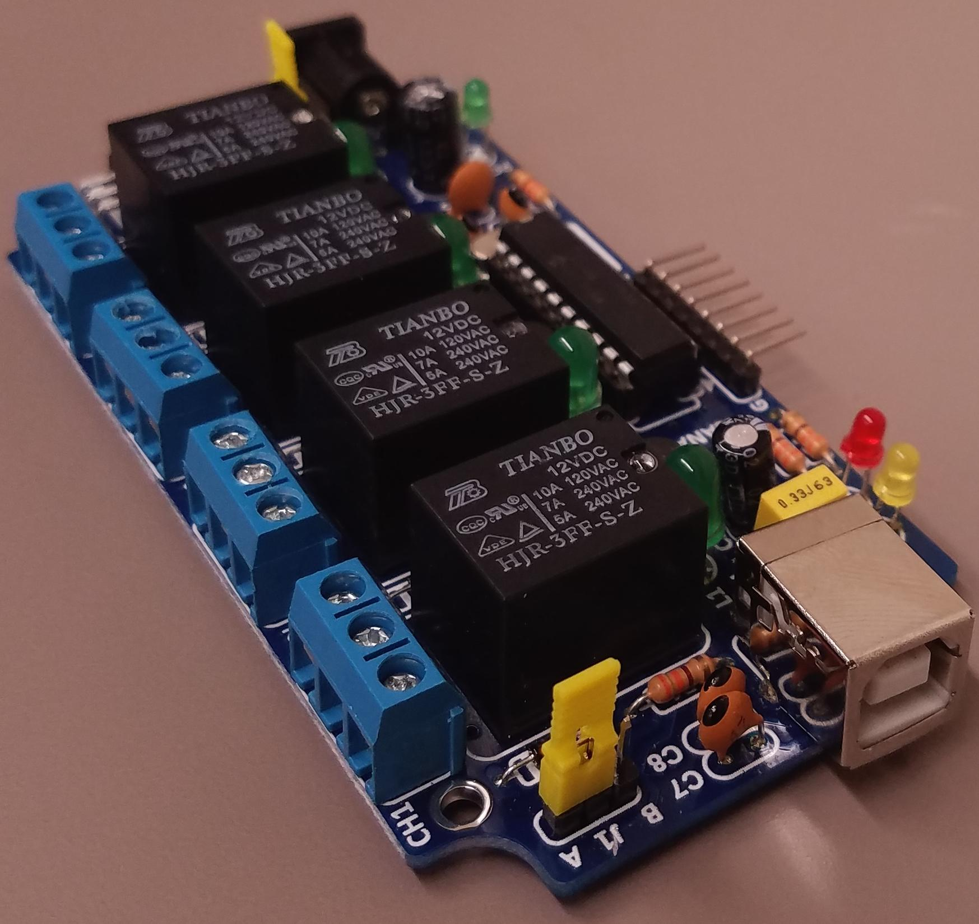
ETCD: Application
Only requires eye movement
Exclusively ETCD controlled
Buttons highlight at a glance
Selection made by staring
Time required for selection is variable
Interface is scalable for ease of use
Phrases can be customized to the user
Can interface with peripheral hardware
Hospital call light
TV, lamp, fan

Slide 11
Design of Server/Client
Server Wrapper
Launches automatically when the Pi boots up
Launches a server program as a child process
If the server quits unexpectedly, reboots Pi
Quickest way to restore functionality
Safeguards against resource leaks
Server program
Receives wireless data from the client on Tim’s tablet
Spawns an appropriate child process designated by the data
Protects server if child fails
Allows for dynamic amount of control

Slide 12
Design of Server/Client
Client code
Runs from within UBTalker program
Will seek out IP address of, and connect to, Pi upon invocation
Transmission of data consists of no more than a few dozen bytes

Slide 13
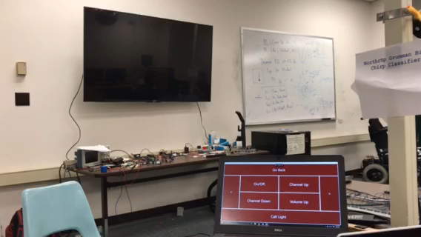
TV Control

Slide 14
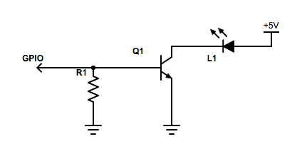
TV Control
Remote device: Raspberry Pi
LIRC Software
Mimics remote
GPIO flashes LED using transistor

Slide 15
Light and Fan Control
Room Control Button
Opens submenu with buttons for room control
TV Control opens menu with TV remote buttons
“Light On/Off” and “Fan On/Off”
Sends “lightToggle” or “fanToggle” to Pi
Program named “lightToggle” or “fanToggle” on Pi flips the output of the respective pin
Light pin and Fan pin activate or deactivate their respective relays
On button press, commands are sent from Desktop UI to a remote device via WLAN (IPv4)

Slide 16
Design of Messaging
Contact List
Google Drive API
Contacts in CSV File
Sending Messages
C# Built in SmtpClient class
There must be a Google Drive that the person managing Tim’s contacts will have access to
In the Google Drive’s root directory, there must be a file named “contacts.csv”
In this file, there should be a single contact on each line in the following format
<Contact Name>, <Contact Number or Email>
Phone numbers must 10 digit and have their carrier’s domain appended

Slide 17
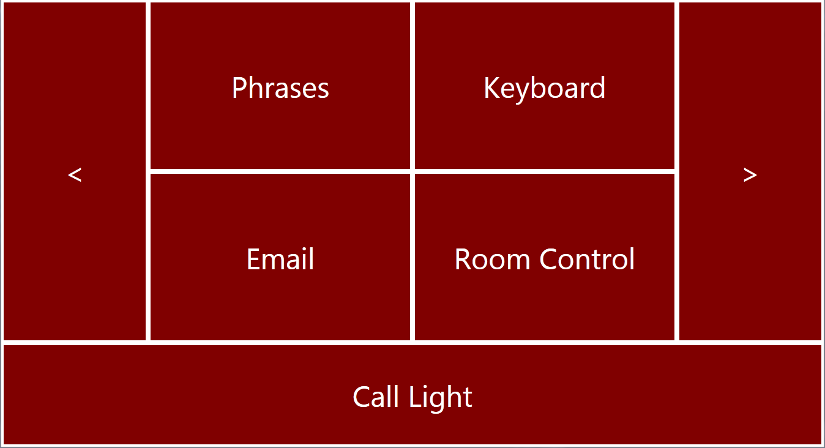
Design of Messaging

Slide 18
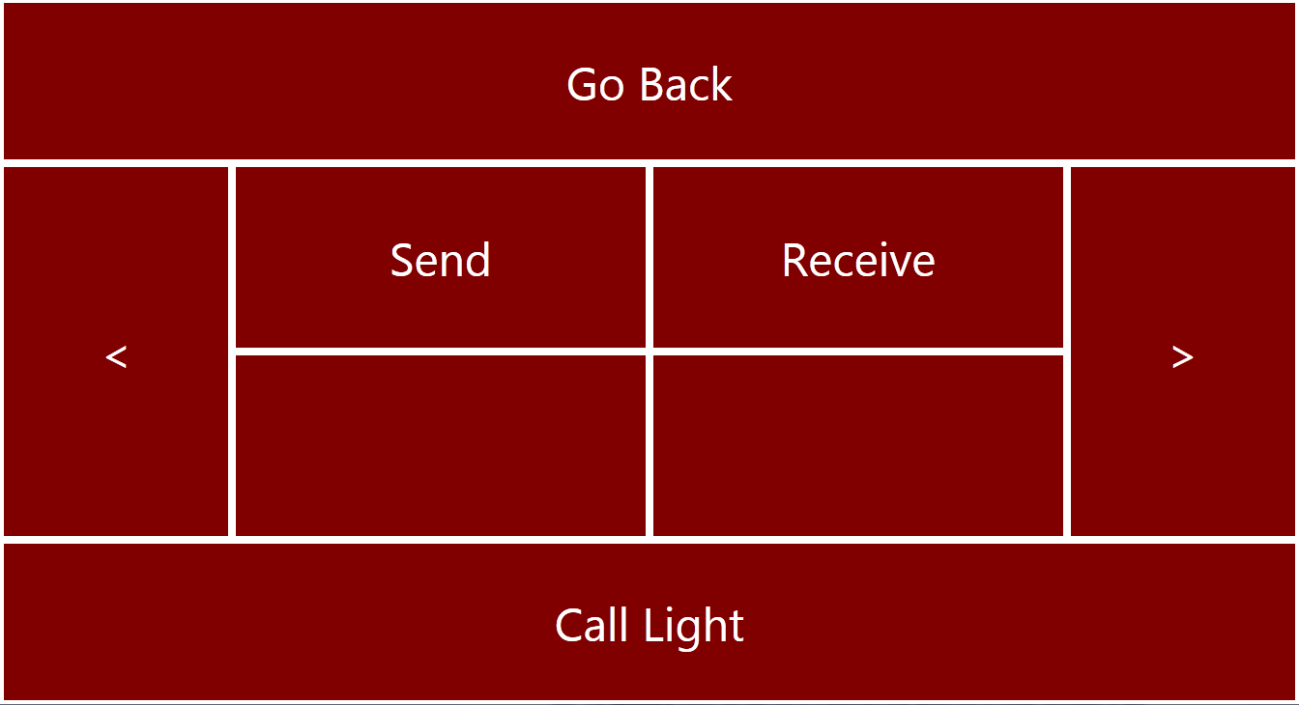
Design of Messaging

Slide 19
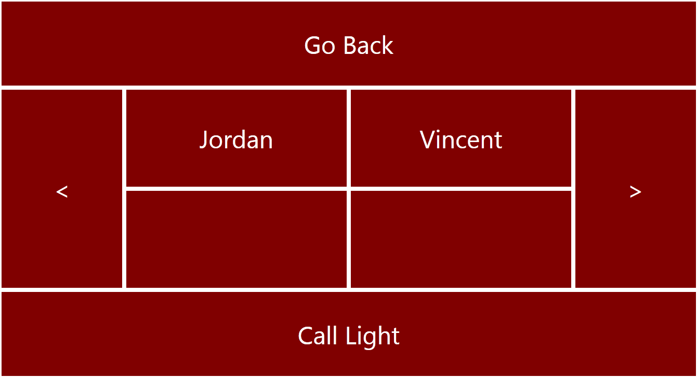
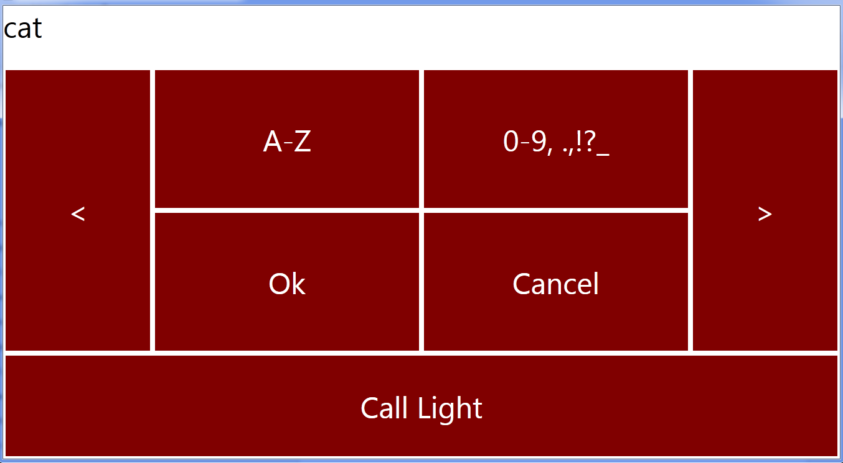
Design of Messaging

Slide 20
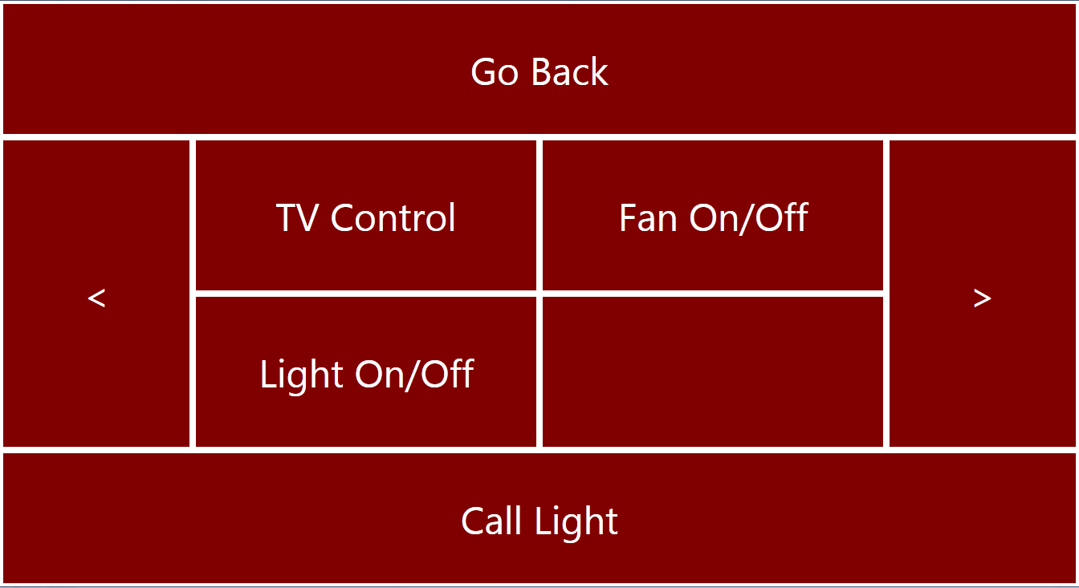
Design of Messaging

Slide 21
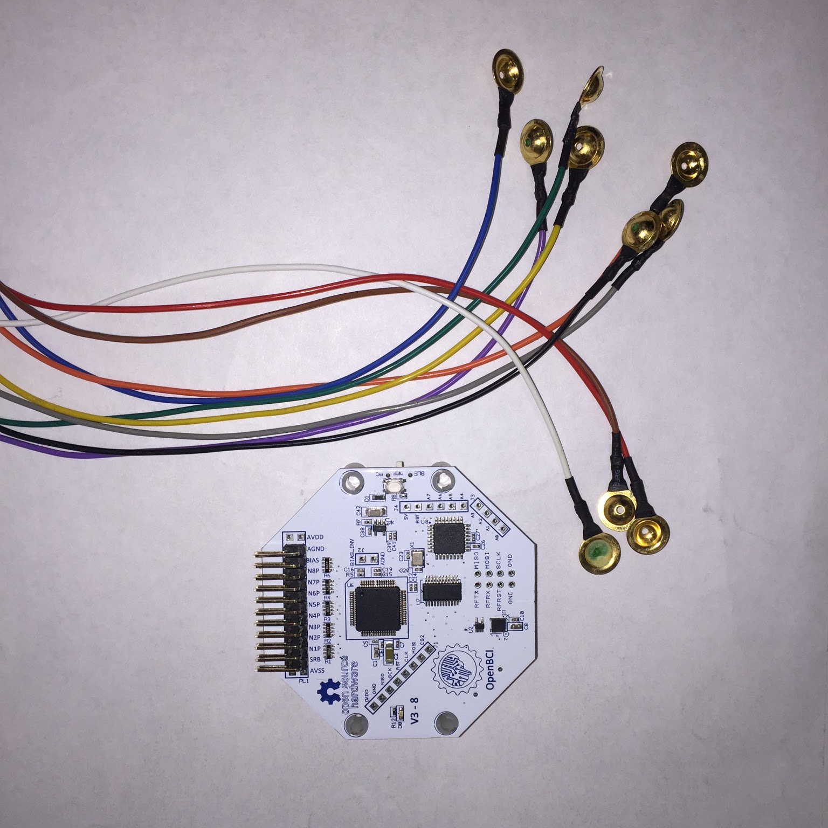
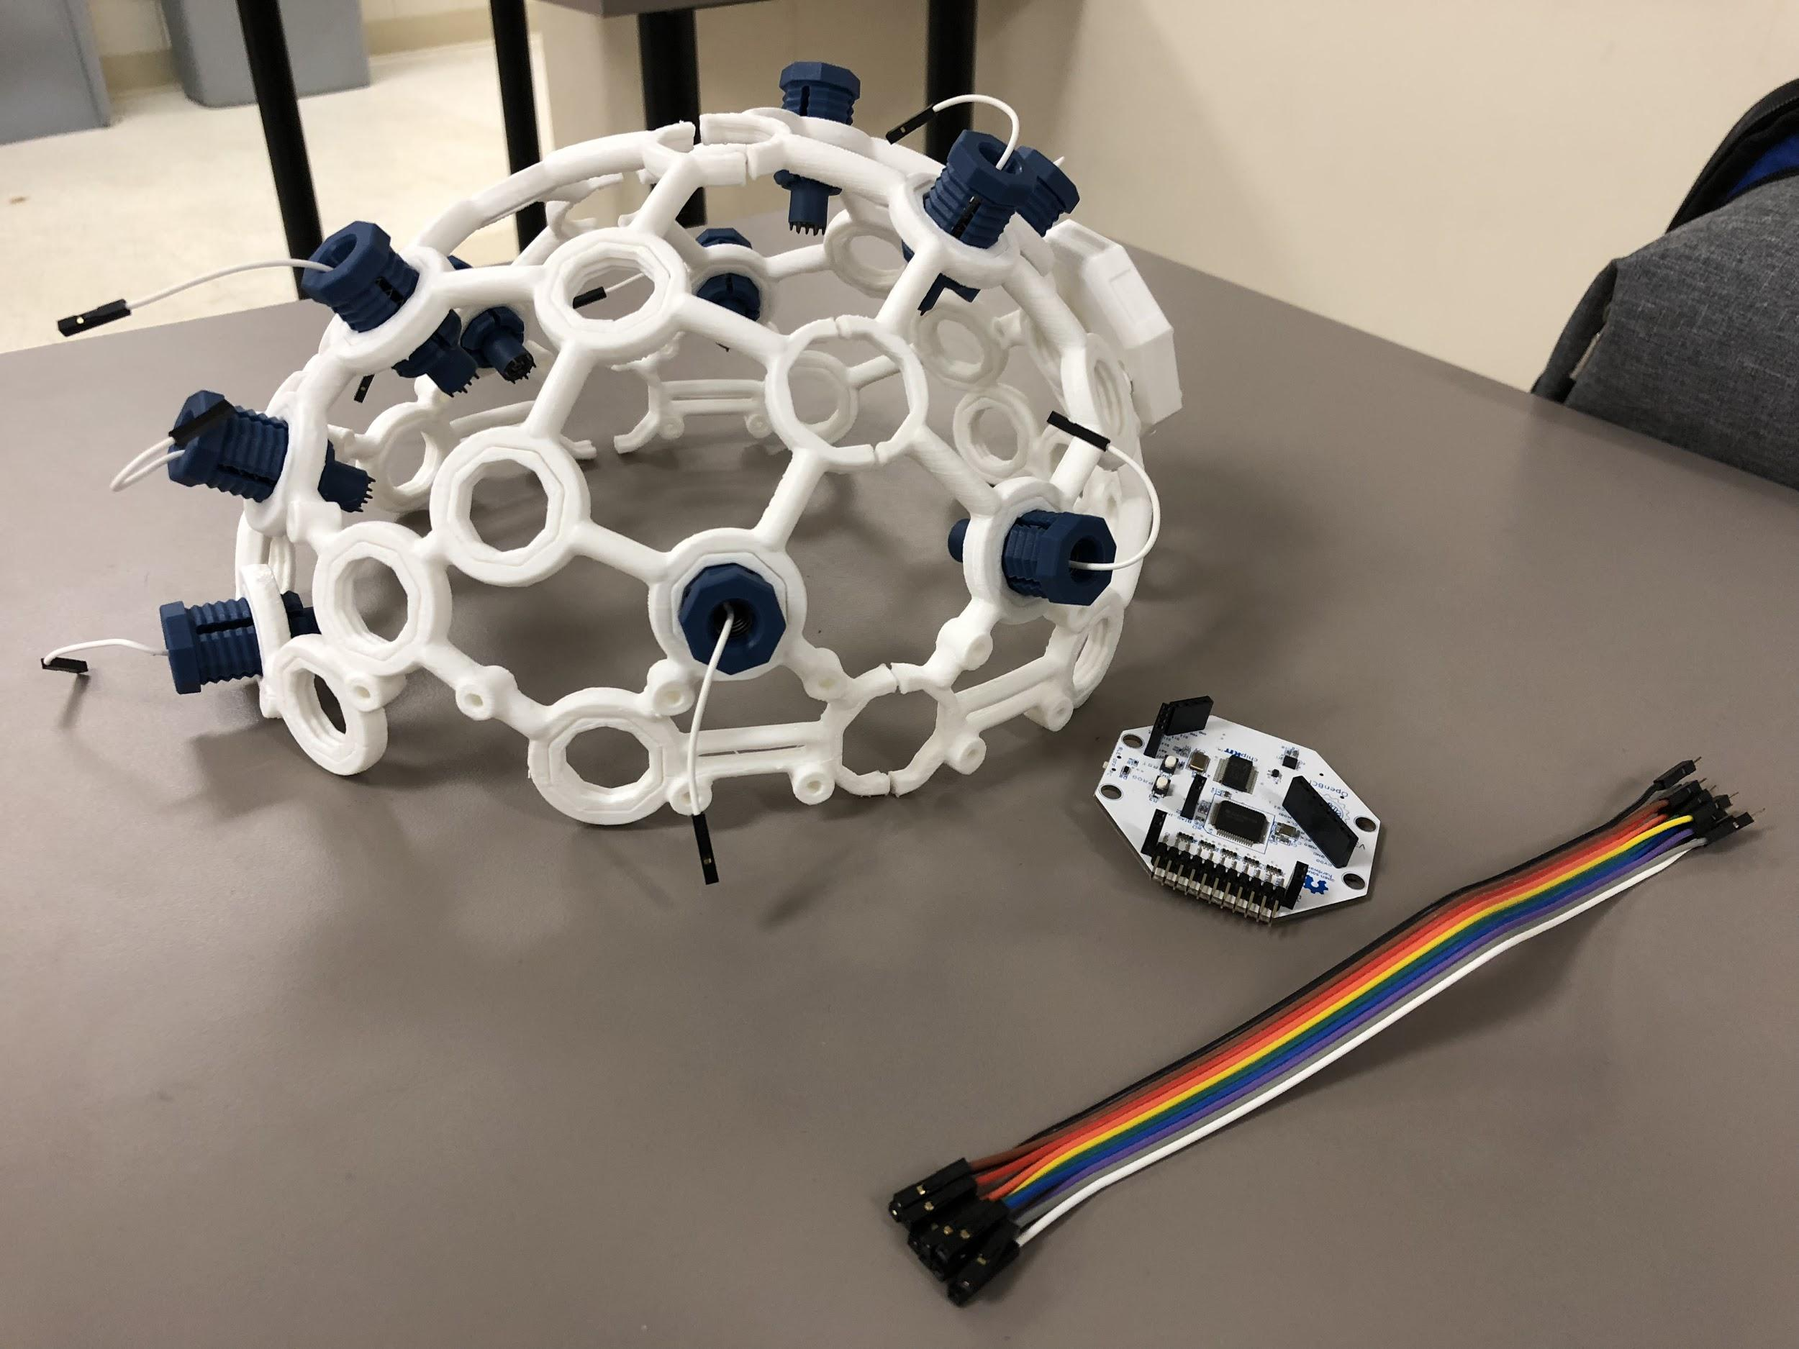
Brain Computer Interface (BCI)
Multiple uses
Electromyography (EMG)
Electroencephalogram (EEG)
Electrocardiogram (EKG)

Slide 22
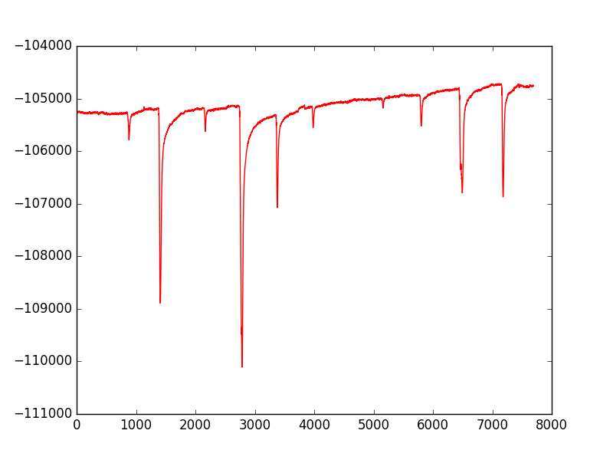
Detecting Eye-Blinks
Consistent Eye- Blink Tracking
EMG
Measures muscle movements (eye blink)
Electrodes placement:
Above right eye (data)
Ear lobes (ground)
Right forearm (filter HR)
Left wrist (filter HR)
Isolate spikes to interpret as mouse clicks
Simple calibration (sensitivity)
Successfully used with Java application

Slide 23
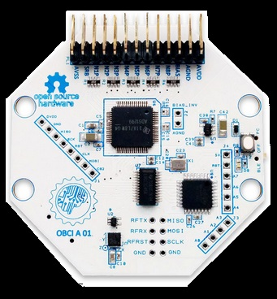
BCI: Current Research
EEG
Attempting to isolate motor cortex
Theory: Thought about movement is simpler than thought about words
Hypothesis: Signals should be simpler to analyze
Thought moves the cursor
Ex: move arm up == cursor move up
Can be used in conjunction with ETCD software
User could switch between ETCD and BCI for control

Slide 24
BCI: Future Goals
EEG - will decipher brain waves involved in speech
First recognize thought patterns of a letter
Progress to words
Ideally a person could think a word and the computer program would speak it aloud
Integrated with other embedded systems
Smart home applications
Lights, Locks, TV
Sending emails and texts with companion software

Slide 25
Challenges
Keeping a step ahead of the progression of the disease and provide a new or updated version of the technology as needed
Developing machine learning techniques that will be used to train the program to recognize the user’s thought patterns
Brain waves read by the BCI will require more filtering to get a clean signal
Must isolate the exact brain wave needed for speech and eliminate the rest
Calibration for the software will be extensive and time consuming

Slide 26
References
A. Chapter, "The ALS Association Greater New York Chapter | New York | New Jersey", The ALS Association Greater New York Chapter, 2017. [Online]. Available: http://als.org/index.php?page=about_als. [Accessed: 11- Apr- 2017].
"How do Tobii Eye Trackers work?", Tobiipro.com, 2017. [Online]. Available: https://www.tobiipro.com/learn-and-support/learn/eye-tracking-essentials/how-do-tobii-eye-trackers-work/. [Accessed: 11- Apr- 2017].
"What are Brainwaves ? Types of Brain waves | EEG sensor and brain wave – UK", Brainworksneurotherapy.com, 2017. [Online]. Available: http://www.brainworksneurotherapy.com/what-are-brainwaves. [Accessed: 11- Apr- 2017].
"OpenBCI - Open Source Biosensing Tools (EEG, EMG, EKG, and more)", Openbci.com, 2017. [Online]. Available: http://openbci.com/?gclid=Cj0KEQjw2-bHBRDEh6qk5b6yqKIBEiQAFUz29gHepd8i1tdJRRL5g8xcUBdc18Lkh5vNFtpH0UMLKXYaAqr38P8HAQ. [Accessed: 11- Apr- 2017].

